Slide 1
FLIGHT TICKET PRICE PREDICTION
BY
V TARAK RAM SAI

Slide 2
PROBLEM STATEMENT
The focus of this project is to develop a machine learning model that predicts the fares of flight tickets. Data used in this article is scraped from yatra.com. This will be a regression problem since the target or dependent variable is the price (continuous numeric value).
To solve this problem, we have been provided with prices of flight tickets for various airlines on the days of March 15 and March 22 of 2022 and between New Delhi and various cities, using which we aim to build a model which predicts the prices of the flights using various input features.
In this project I have applied Machine learning algorithms on a dataset consisting of various factors which can influence the flight fares to prepare such a model.

Slide 3
Data Description
Airline: The name of the airline.
Source: The source from which the service begins.
Destination: The destination where the service ends.
Dep_Time: The time when the journey starts from the source.
Arr_Time: Time of arrival at the destination.
Duration: Total duration of the flight.
Date: The date of the journey
No_of_Stops: Total stops between the source and destination.
Price: The price of the ticket

Slide 4
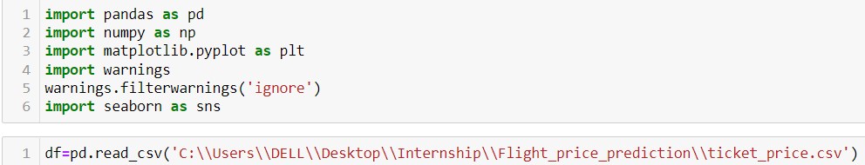
Data Pre-Processing
It entails converting raw data into comprehensible format that a machine learning model can understand. The data pre-processing involves data cleaning which involves handling missing values, transformation of data i.e. normalizing the data and data reduction which involves only required features.

Slide 5
Data Cleaning
Data cleaning is one of the important parts of machine learning. It plays a significant part in building a model. Data cleaning is the process of preparing data for analysis by weeding out information that is irrelevant or incorrect. This is generally data that can have a negative impact on the model or algorithm it is fed into by reinforcing a wrong notion. Data cleaning not only refers to removing chunks of unnecessary data, but it’s also often associated with fixing incorrect information within the dataset and reducing duplicates.

Slide 6
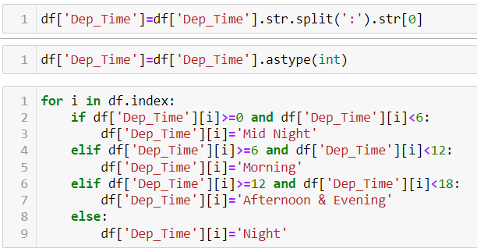
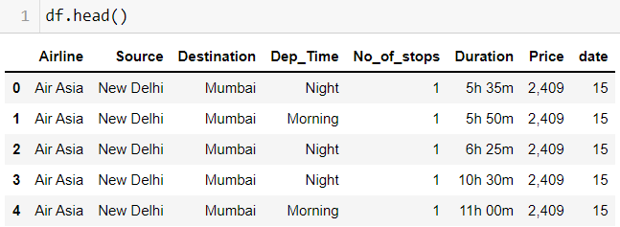
Data Cleaning
We can divide the Departure timings into 4 quarters like Morning, Afternoon-Evening, Night and Mid-Night.
Then the dataframe will be as follows-

Slide 7

Data Reduction
The next step of data processing is data reduction. This is used to remove duplicate features present in the data i.e. unwanted features for prediction.
Dropping "source" column because all the rows has source as New Delhi and dropping "Data" because I created date column for better analysis. We can also delete Arrival Column, because Departure time and Duration gives the same information.

Slide 8
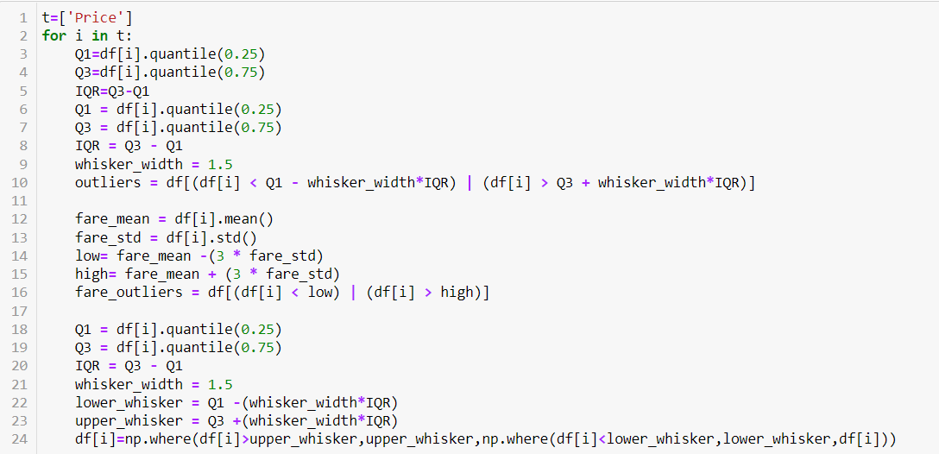
Handling Outliers
Instead of eliminating the outliers, we have replaced the outliers higher than the upper whisker by the value of upper whisker and the outliers lower than the lower whisker by the value of lower whisker.

Slide 9
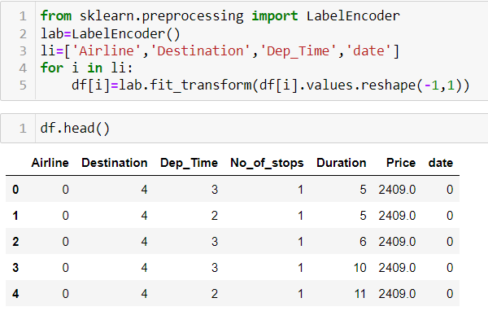
Encoding
Encoding categorical data is a process of converting categorical data into integer format so that the data with converted categorical values can be provided to the different models.

Slide 10
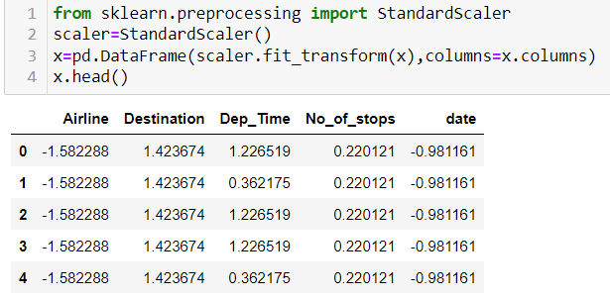
Scaling
Feature scaling is a method used to normalize the range of independent variables or features of data. To convert data into a distribution with a mean of 0 and standard deviation of 1, we will use a standard scalar.

Slide 11
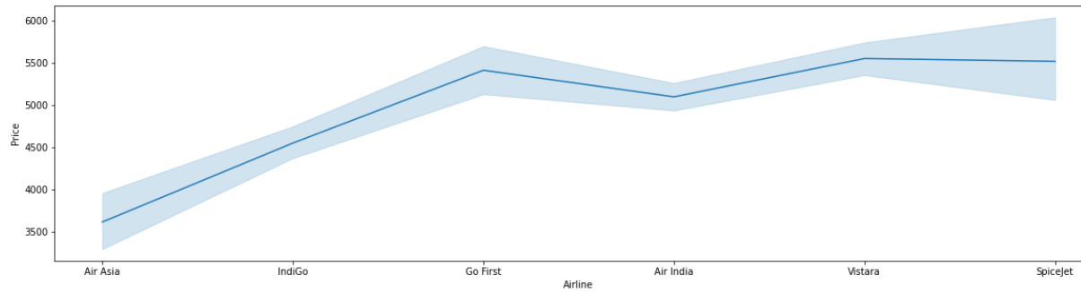
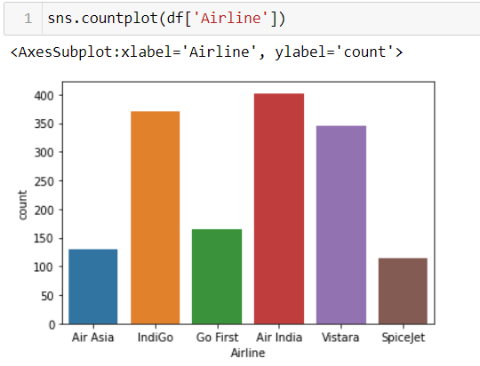
Data Inputs- Logic- Output Visualization
Go First and Vistara are the costliest airlines compared to others.
Number of Air India and IndiGo flights are more in the dataset.

Slide 12
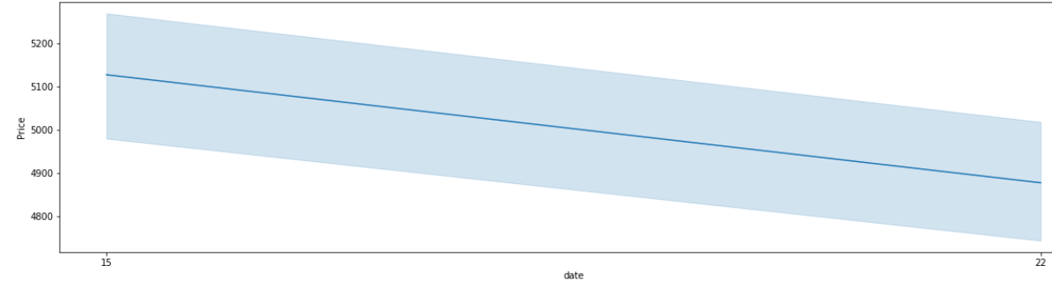
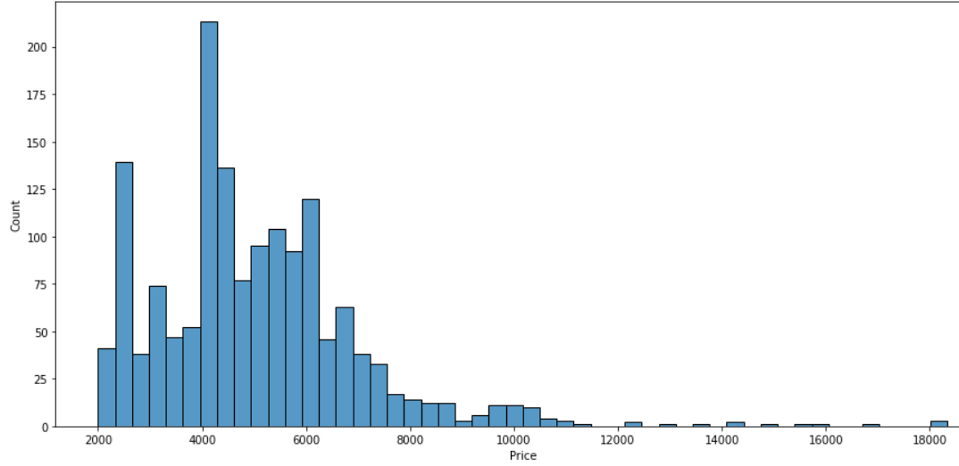
Data Inputs- Logic- Output Visualization
The flights on March 22nd are cheaper than rates on March 15th.
Most of the Ticket prices are in the range of 4000 - 6000.

Slide 13
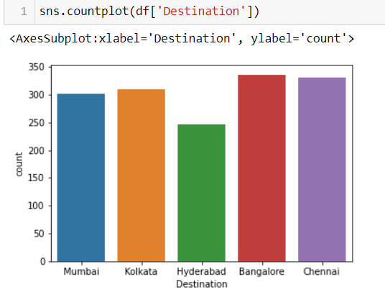
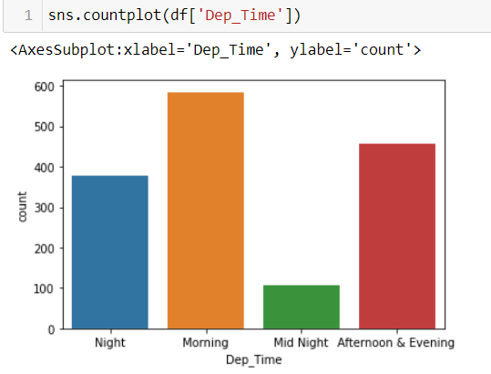
Data Inputs- Logic- Output Visualization
There are more flights to Bangalore and Chennai from Delhi.
There are more flights in Day Time.

Slide 14
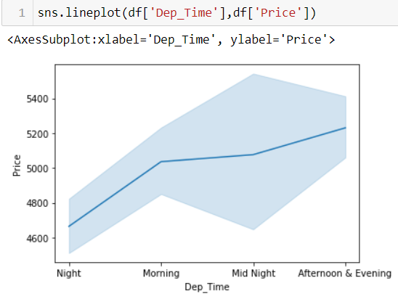
Data Inputs- Logic- Output Visualization
The flight ticket prices at night time are cheaper.

Slide 15
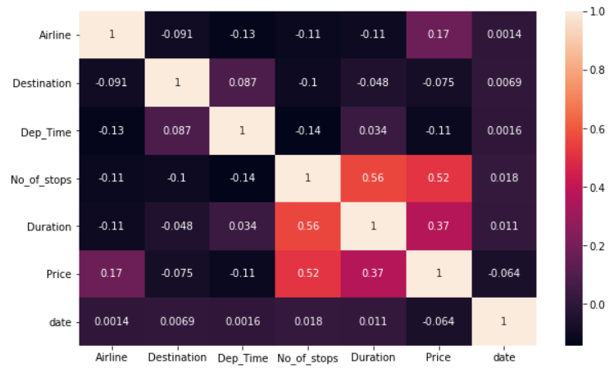
Data Inputs- Logic- Output Visualization
Price is mostly depends on Airline, Number of stops and Duration.

Slide 16

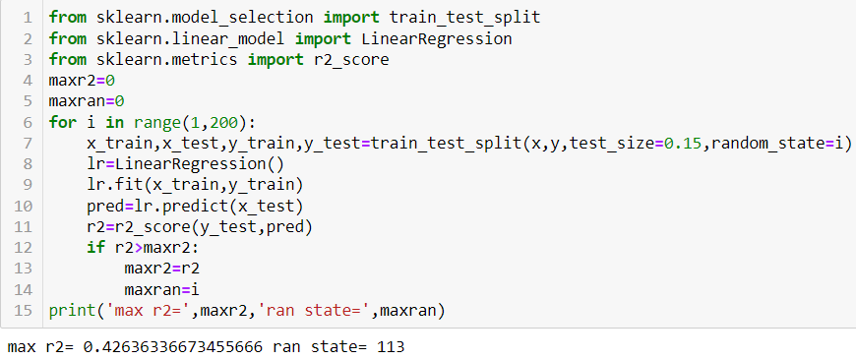
Model/s Development and Evaluation
The independent variables are declared in x and the dependent variable i.e. ‘Price’ is declared in y as follows-
The below code is done for choosing
the Random state variable. We should do
testing by using any of the three regression
algorithms.

Slide 17
Hyper Parameter Tuning
In machine learning, hyper parameter optimization or tuning is the problem of choosing a set of optimal hyper parameters for a learning algorithm. A hyper parameter is a parameter whose value is used to control the learning process. By contrast, the values of other parameters (typically node weights) are learned.
Hyperparameter tuning is choosing a set of optimal hyperparameters for a learning algorithm. A hyperparameter is a model argument whose value is set before the learning process begins. The key to machine learning algorithms is hyperparameter tuning.

Slide 18
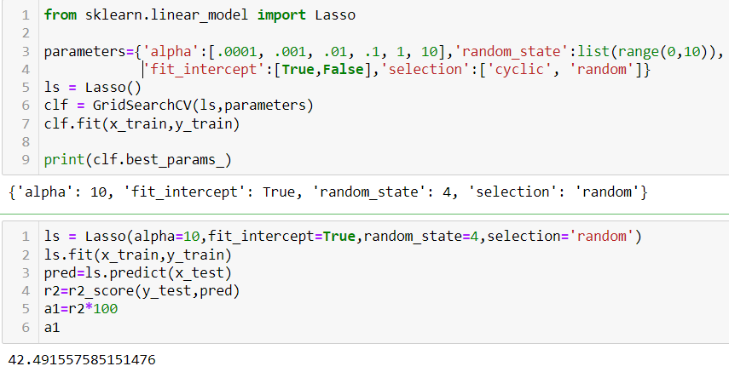
Lasso Regression
The “LASSO” stands for Least Absolute Shrinkage and Selection Operator. Lasso regression is a regularization technique. It is used over regression methods for a more accurate prediction.
This model uses shrinkage. Shrinkage is where data values are shrunk towards a central point as the mean. The lasso procedure encourages simple, sparse models (i.e. models with fewer parameters).

Slide 19
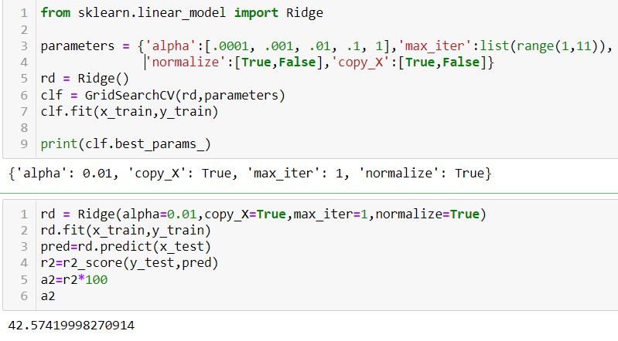
Ridge Regression
A Ridge regressor is basically a regularized version of Linear Regressor. The regularized term has the parameter ‘alpha’ which controls the regularization of the model i.e. helps in reducing the variance of the estimates.

Slide 20
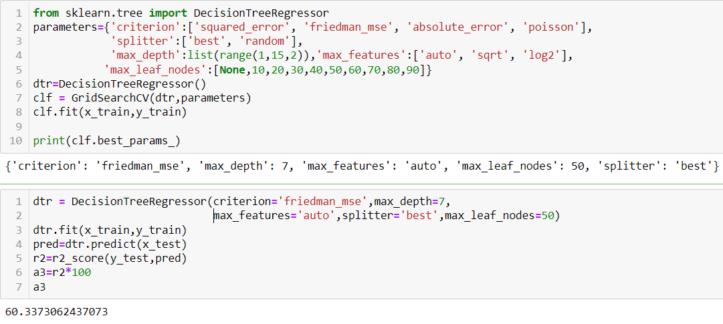
Decision Tree Regression
Decision tree builds regression or classification models in the form of a tree structure. It breaks down a dataset into smaller and smaller subsets while at the same time an associated decision tree is incrementally developed. The final result is a tree with decision nodes and leaf nodes.

Slide 21
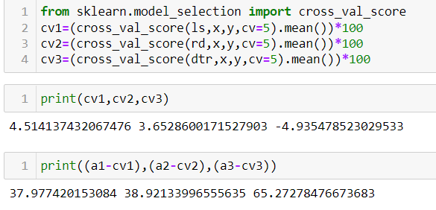
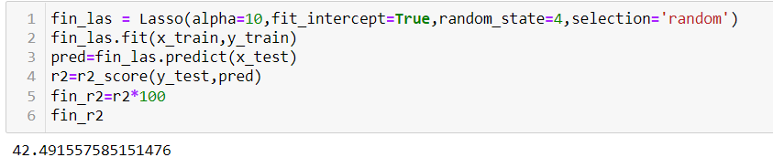
Cross Validation
Cross Validation is a very useful technique for assessing the effectiveness of your model, particularly in cases where you need to mitigate overfitting.
We can choose Lasso Regression as our model since its cross validation score and accuracy score are almost similar.

Slide 22
Key Findings and Conclusions of the Study
Flight price prediction can be a challenging task due to the various types of attributes that should be considered for the accurate prediction. The major step in the prediction process is collection of data and pre-processing of the data. In this research, the model is built to normalize, standardize and clean data to avoid unnecessary noise for machine learning algorithms.
Data cleaning is one of the processes that increases prediction performance. The main attributes that contribute to the price of flight ticket are the type of airlines, no of stops between source and destination, duration of journey and date of journey. The above mentioned are the main attributes that influence the ticket price.

Slide 23
Key Findings and Conclusions of the Study
For better performance, we plan to judiciously design deep learning network structures, use adaptive learning rates and train on clusters of data rather than the whole dataset. To correct for overfitting in Random Forest, different selections of features and number of trees will be tested to check for change in performance.
However, the drawback of the proposed system is that it consumes much more computational resources than single machine learning algorithm.

